Slide 1

Journey Of Hunting macOS Kernel
Nguyen Vu Hoang (Peter)

Slide 2
About me
Nguyen Vu Hoang (Peter), Security Researcher at STAR Labs.
Focusing on macOS/iOS bug hunting and exploitation.
Awarded bounties by Apple Security Platform.
Identified some Apple vulnerabilities from user-level to kernel-level:
CVE-2022-22593: XNU kernel Heap overflow.
CVE-2021-30868: SMBFS Use-After-Free allows attackers to to escalate privileges on macOS.
CVE-2021-30745: QuartzCore type confusion allows the attacker to escape the Safari sandbox.
CVE-2020-9816: libFontParser Out-of-Bounds Write allows attackers to gain code execution in the Safari renderer process.

Slide 3
Agenda
SMBFS Reconnaissance
Fuzzing Methodology
CVE-2021-30868 Root cause analysis
CVE-2021-30868 Exploitation
Demo
Q&A

Slide 4
1. SMBFS Reconnaissance

Slide 5
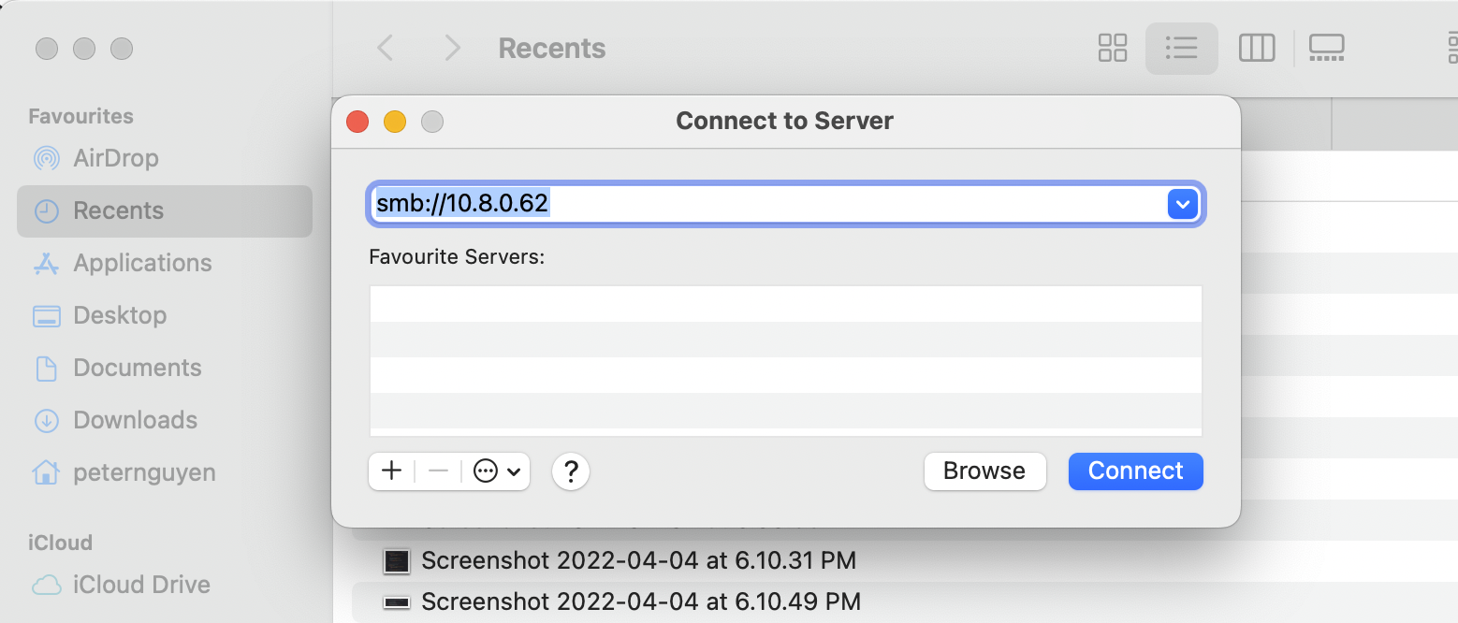
How to connect to Samba Server in macOS

Slide 6
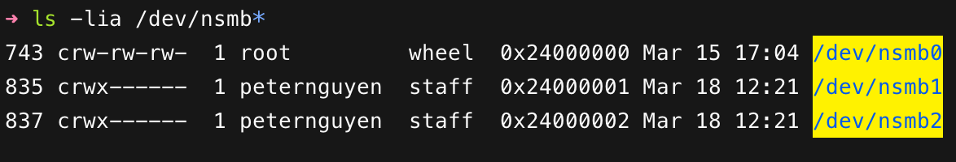

Why SMBFS (Samba File System)?
SMBFS (Samba Filesystem) is exposed in the system as a char-dev (Character Device) device:
These char-dev devices can easily be accessed with user permissions.

Slide 7
What is SMBFS?
SMBClient is an open source project at https://opensource.apple.com/releases/.
SMBClient version 231.60.3 is the one I focus on.
SMBClient has two (02) parts:
User-space: implementing a framework APIs and a plugin for Finder to connect to samba server and to mount shared network drive into system directory.
Kernel-space:
netsmb (char-dev): authentication, connection management, URL translation, etc.
smbfs: responsible for implementation of generic syscalls such as: mount, open, read, write, unlink, etc to help the kernel recognize the shared network drive as a normal drive.

Slide 8


Three initial issues and solutions
Issues
Solutions
smbfs.kext is not loaded automatically when macOS boots.
To load smbfs.kext with user permission
Many weird /dev/nsmb(number) devices in /dev directory.
To load netsmb into kernel
/dev/nsmb0 has root permissions and the rest have user permissions.
To create netsmb char-dev with user permission

Slide 9
What are the solutions
in details?

Slide 10
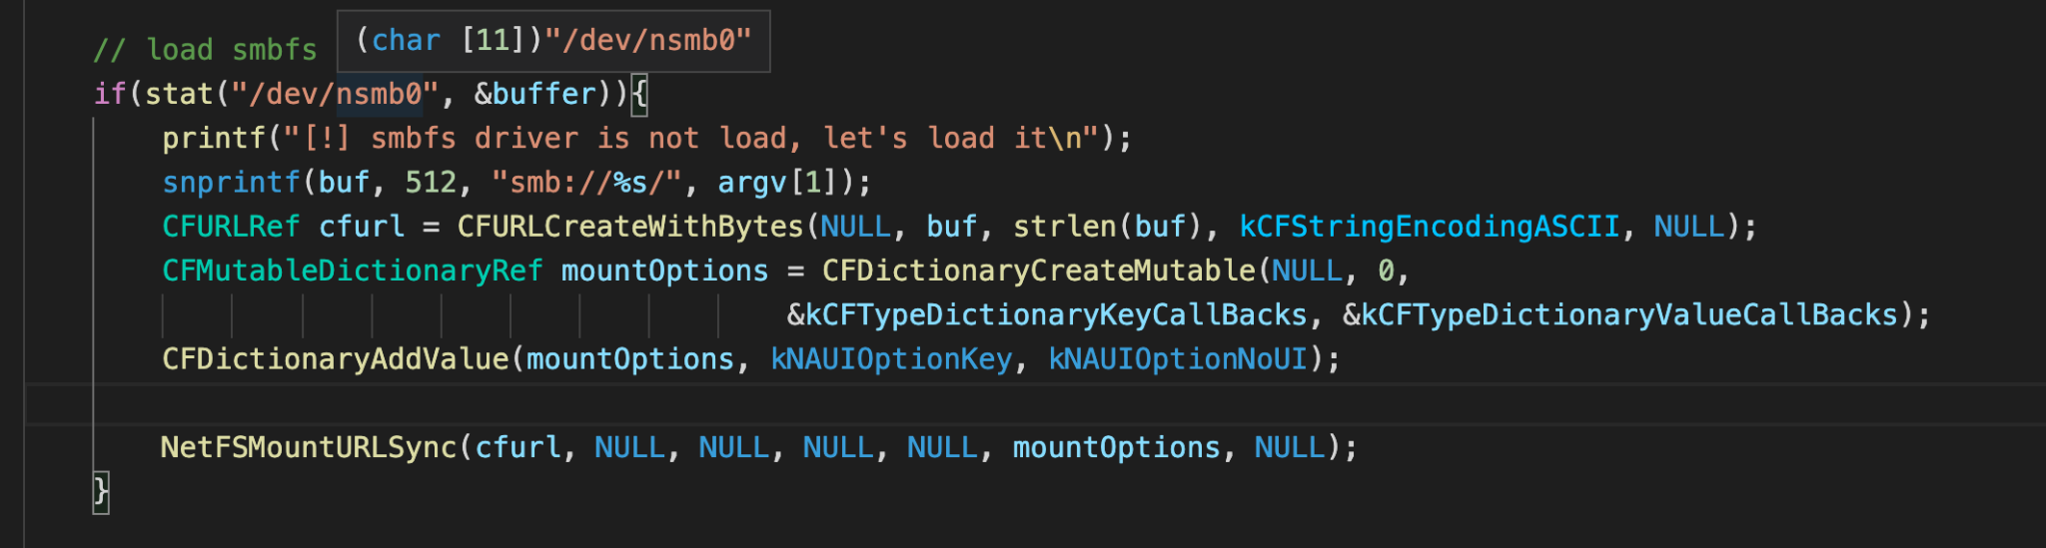
Solution #1: Loading smbfs.kext with user permission
NetFSMountURLSync is an API to load smbfs.kext.
This API will send XPC message to aspd service to load smbfs.kext without any permission.

Slide 11
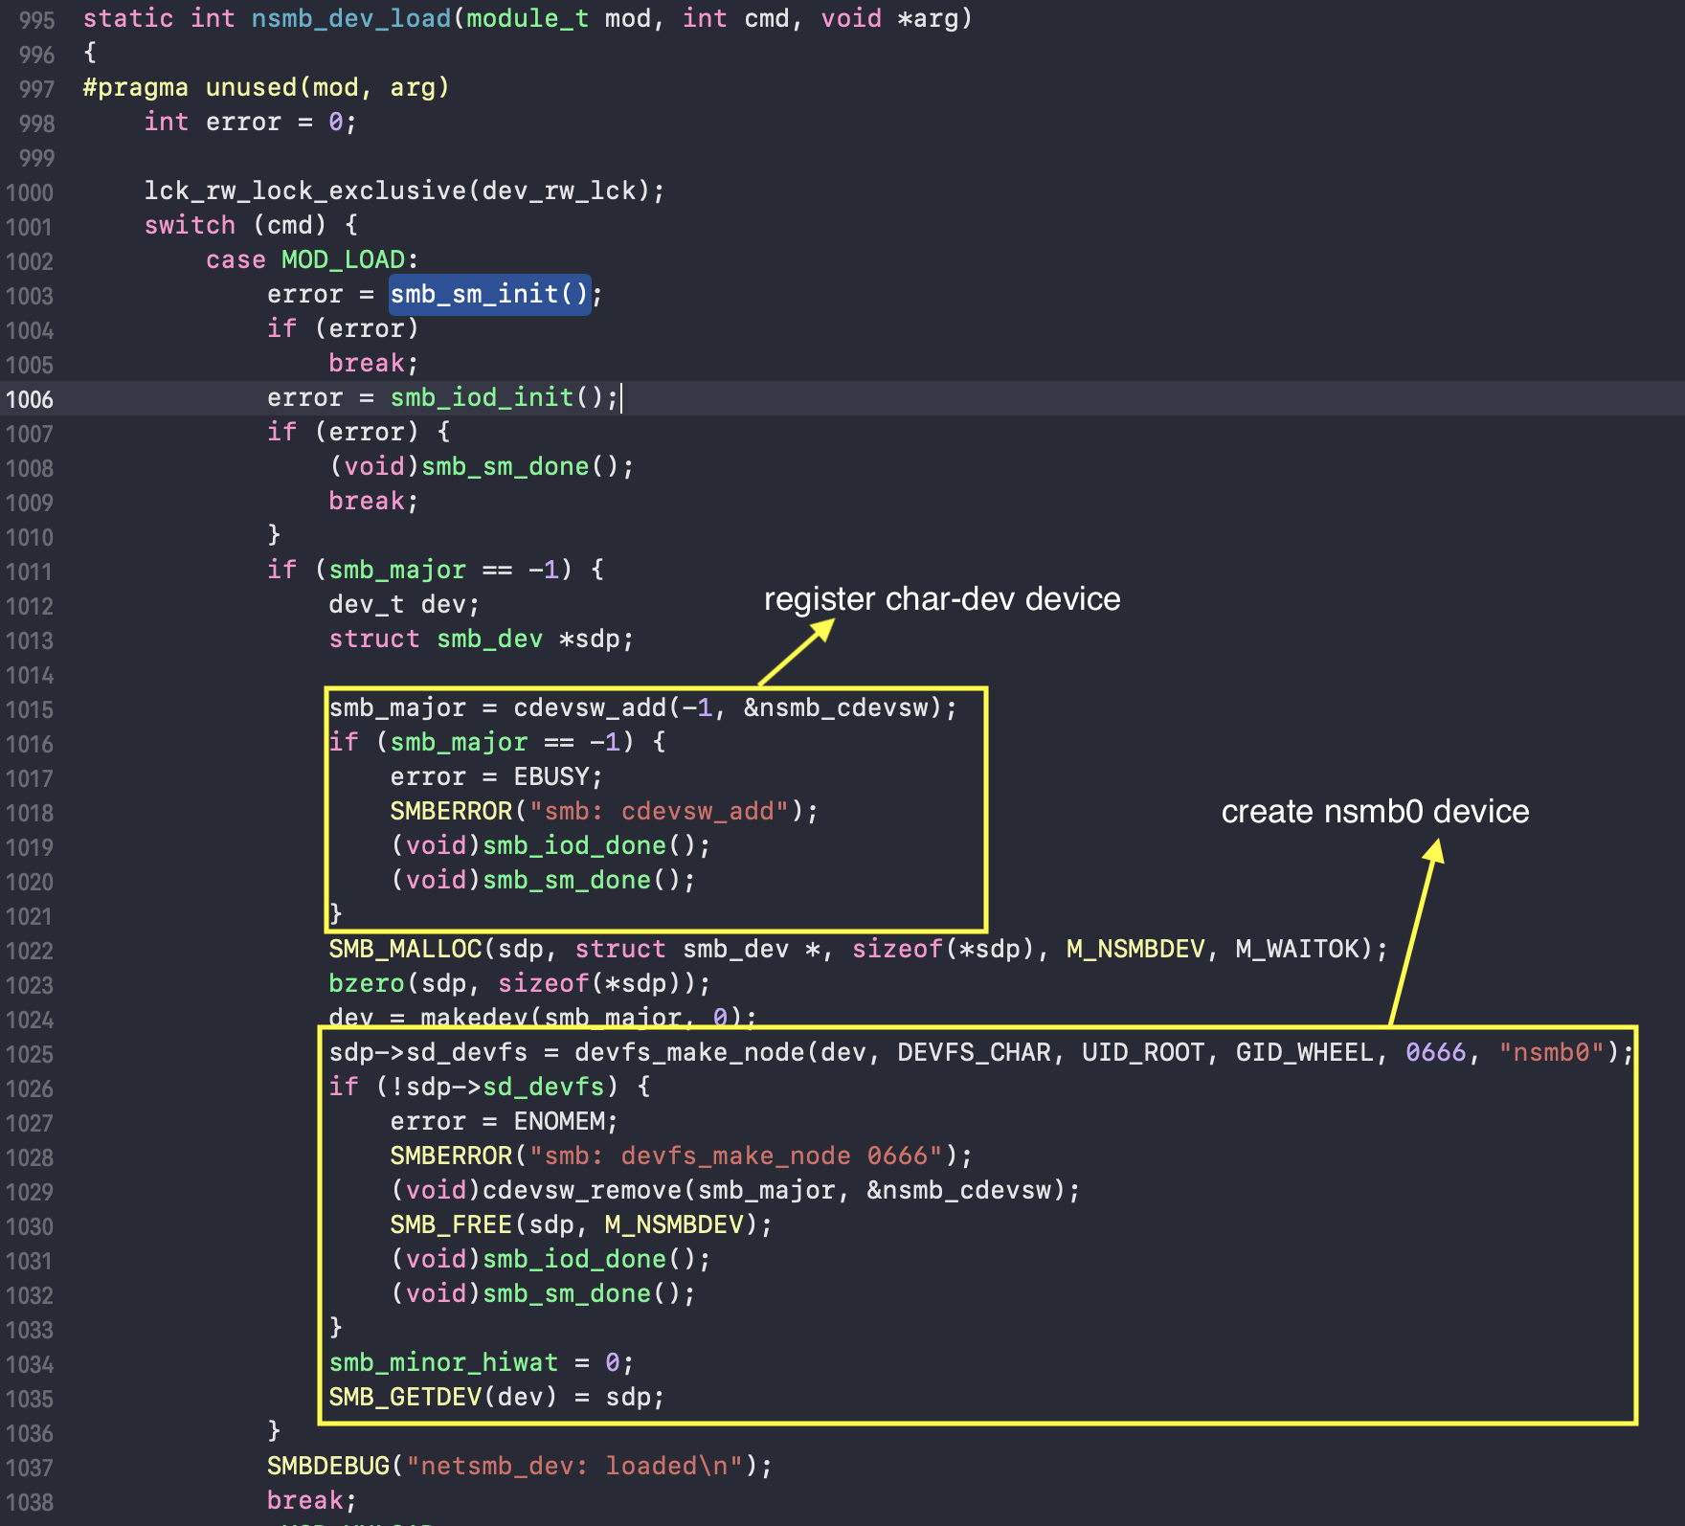
Solution #2: Loading netsmb into kernel
nsmb_dev_load: initializing some states for smbfs.kext and creating /dev/nsmb0.

Slide 12
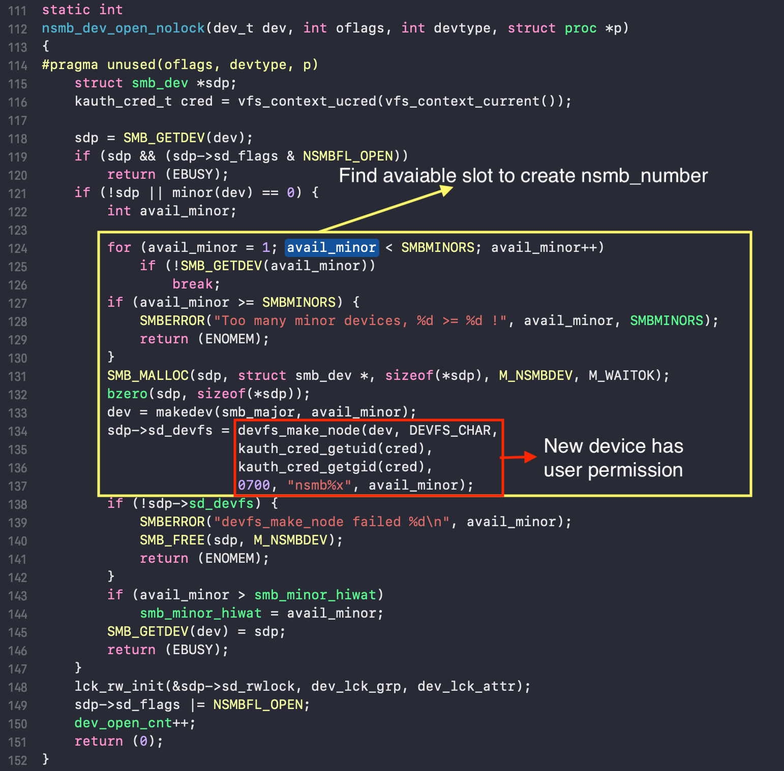
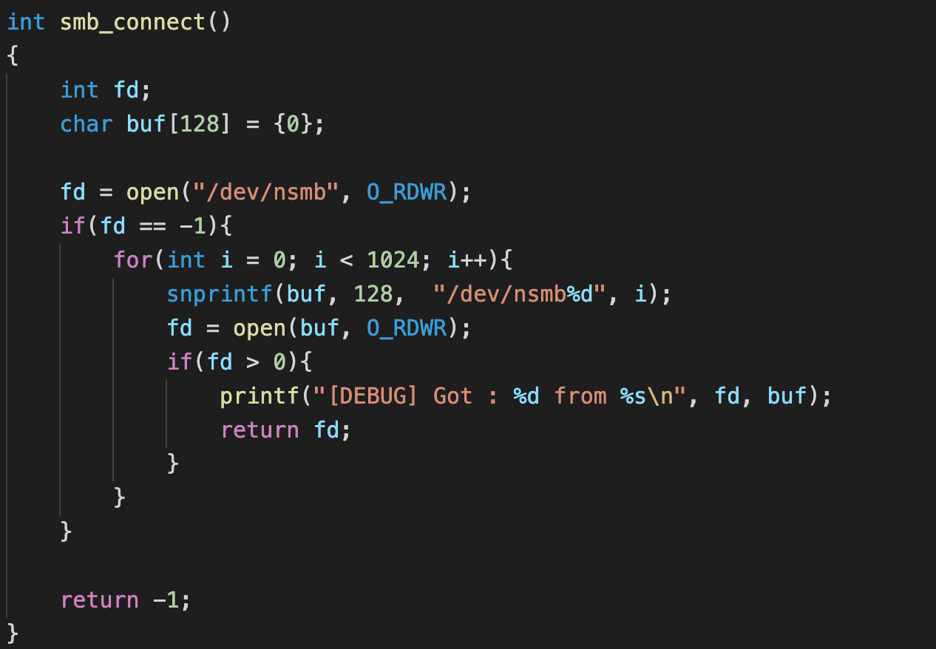
Solution #3: Creating netsmb char-dev device
nsmb_dev_open: syscall open handler for /dev/nsmb device. If users called syscall open to the device, it will create /dev/nsmb(number).

Slide 13
How to interact with netsmb device?
netsmb provides 27 IOCTL commands.
Here are some special commands I focused on:
SMBIOC_NEGOTIATE, SMBIOC_FIND_SESSION
SMBIOC_SSNSETUP
SMBIOC_TCON
The above IOCTL commands perform samba negotiation, authentication, connection and disconnection.
These IOCTL commands need to be called first if users want to use the other commands.

Slide 14
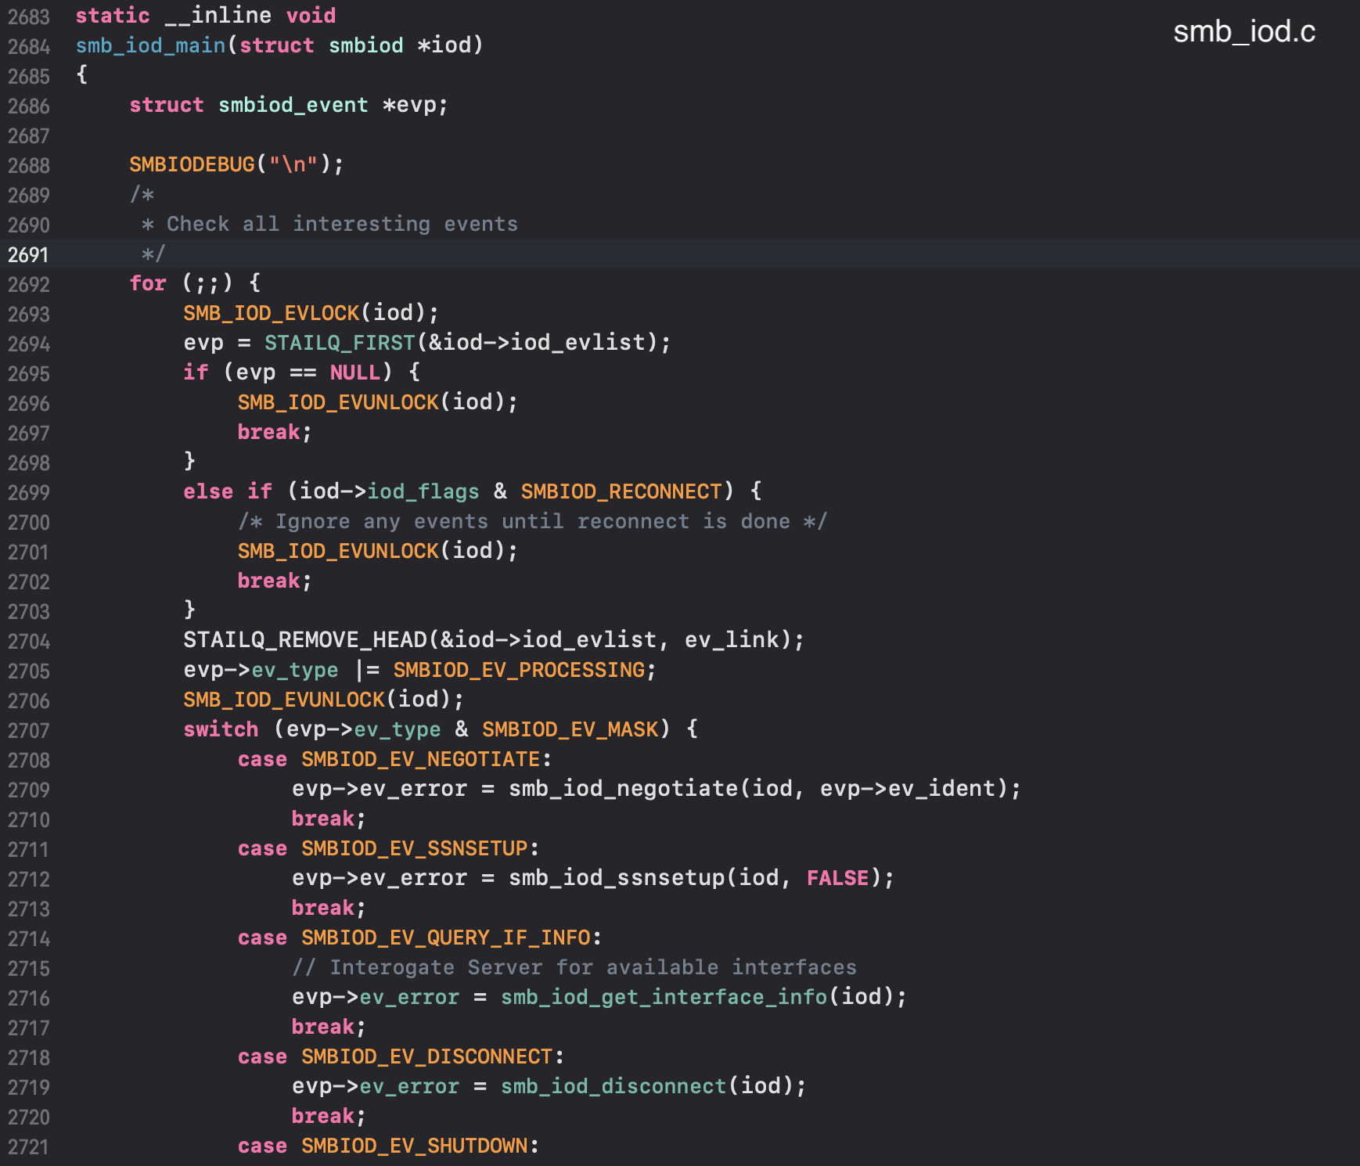
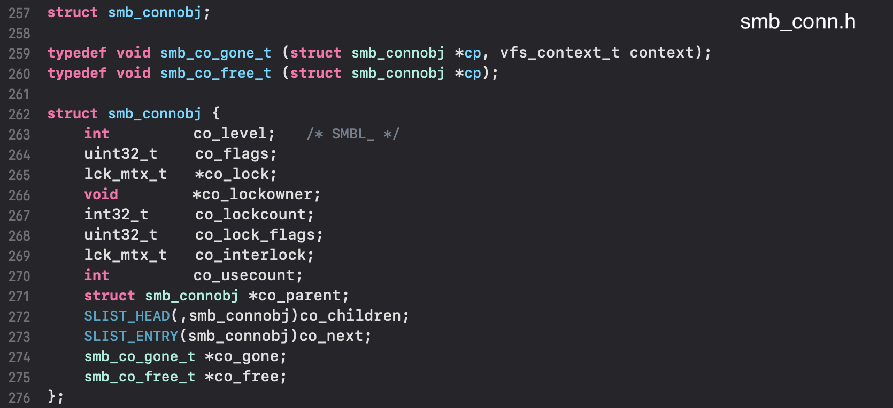
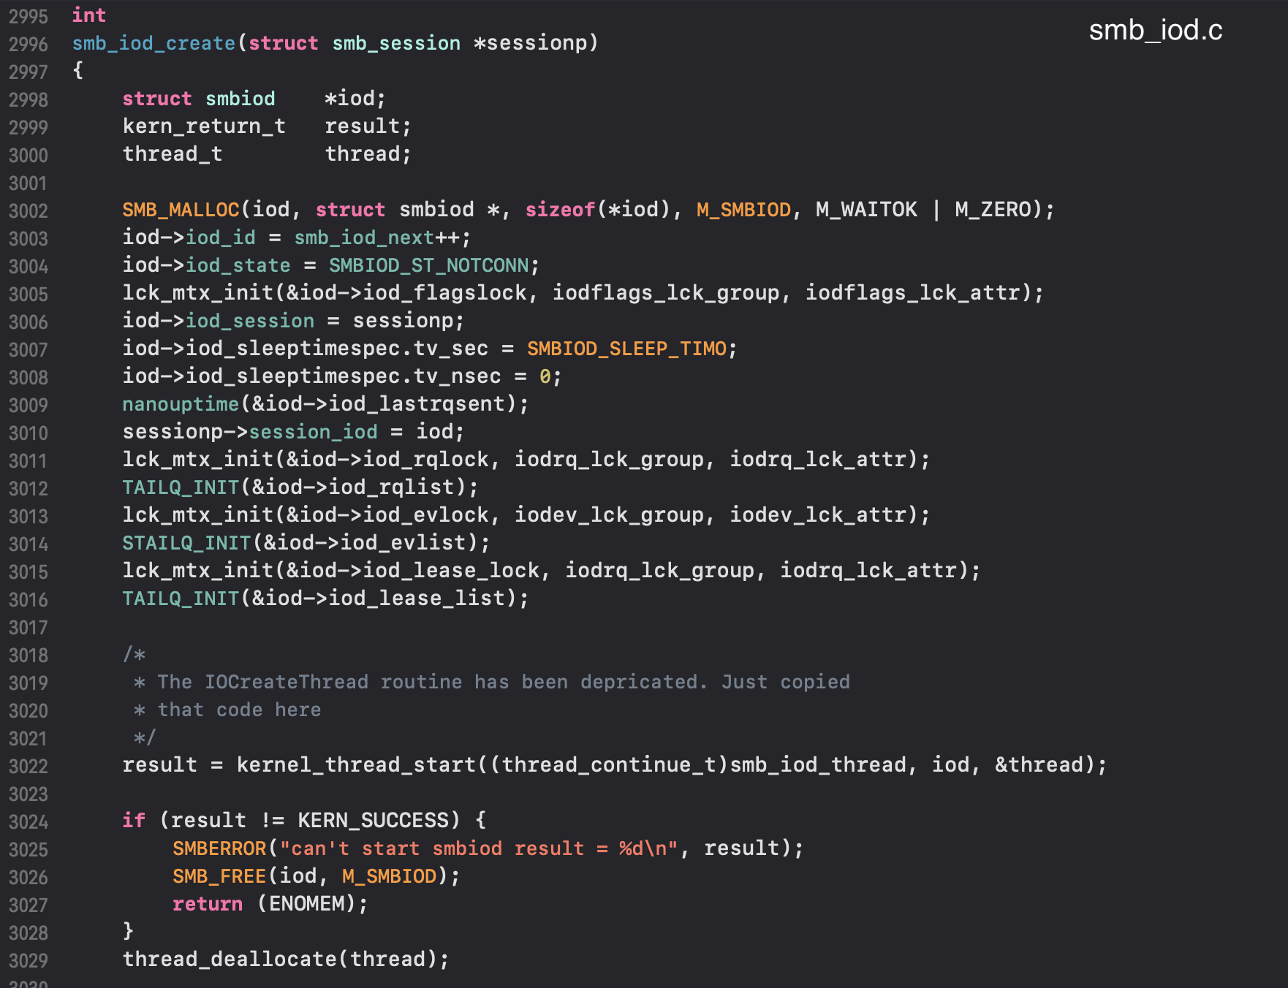
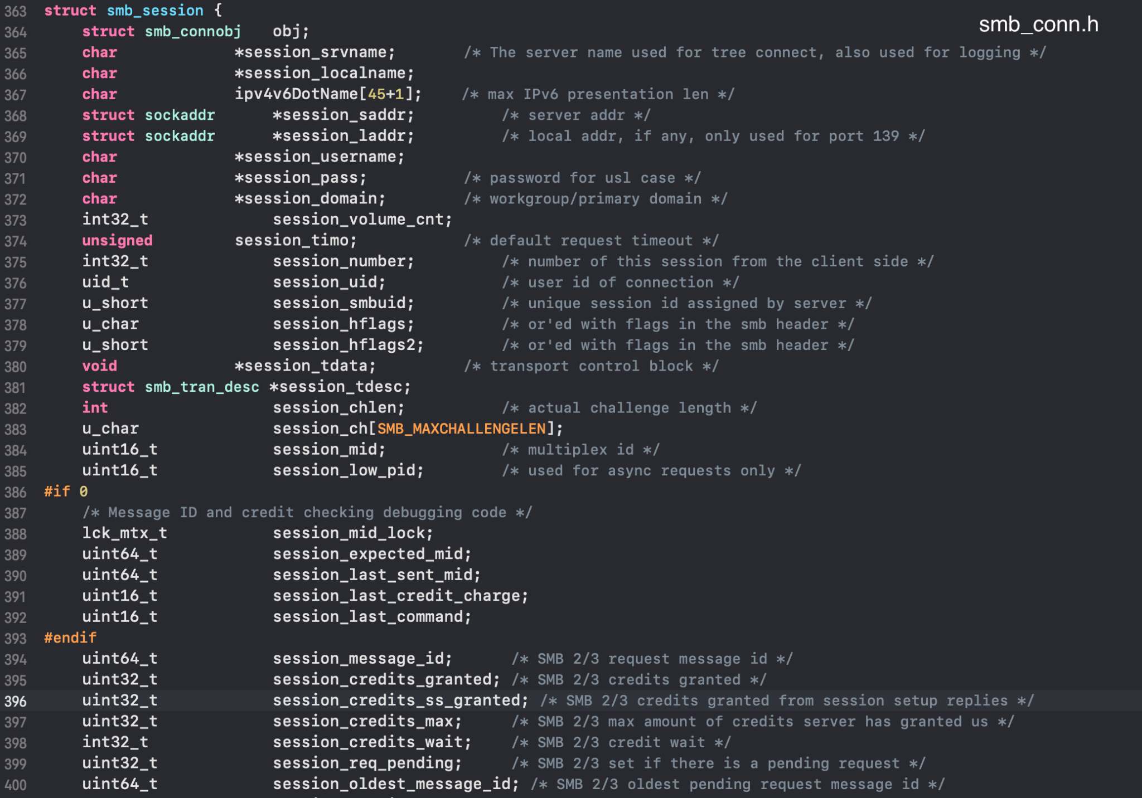
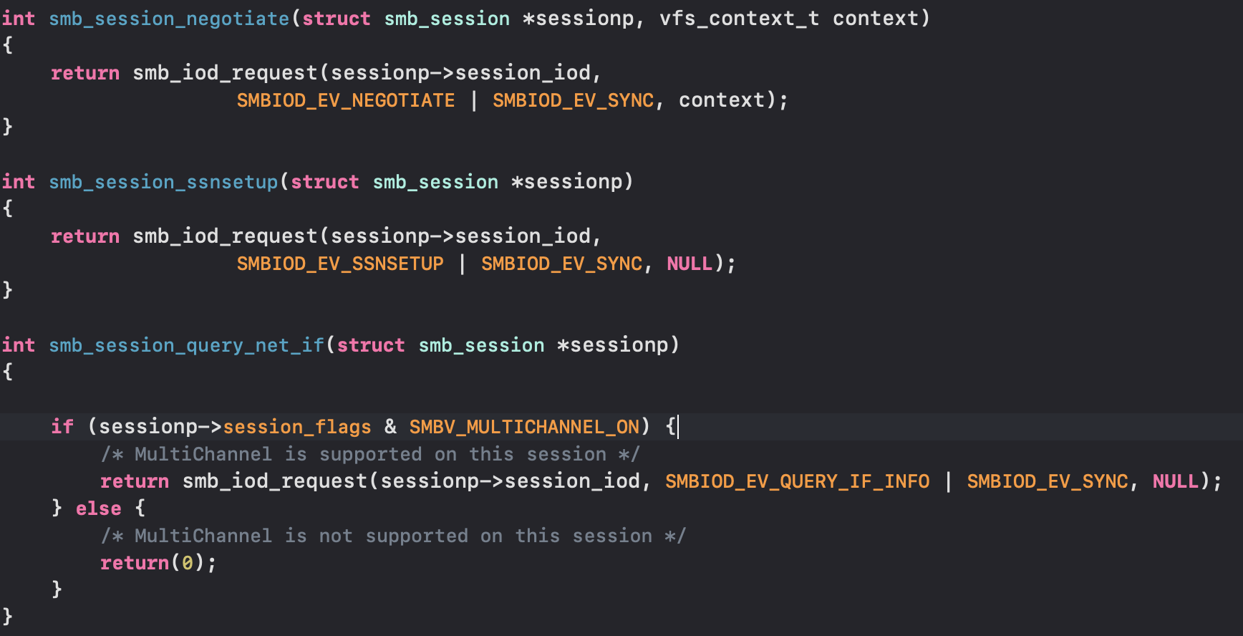
How did SMBIOC_NEGOTIATE negotiate to samba server?
SMBIOC_NEGOTIATE and SMBIOC_FIND_SESSION negotiate with samba server.
SMBIOC_NEGOTIATE creates smb_session struct to store information for samba connection which has reference counter that could be shared among nsmb char-devs via SMBIOC_FIND_SESSION
smbiod: a structure to store information shared to smb_iod_thread, smb_iod_lease_thread and smb_iod_read_thread.
SMBIOC_NEGOTIATE sends an event to smb_iod_thread to negotiate with samba server and wait for result signal

Slide 15
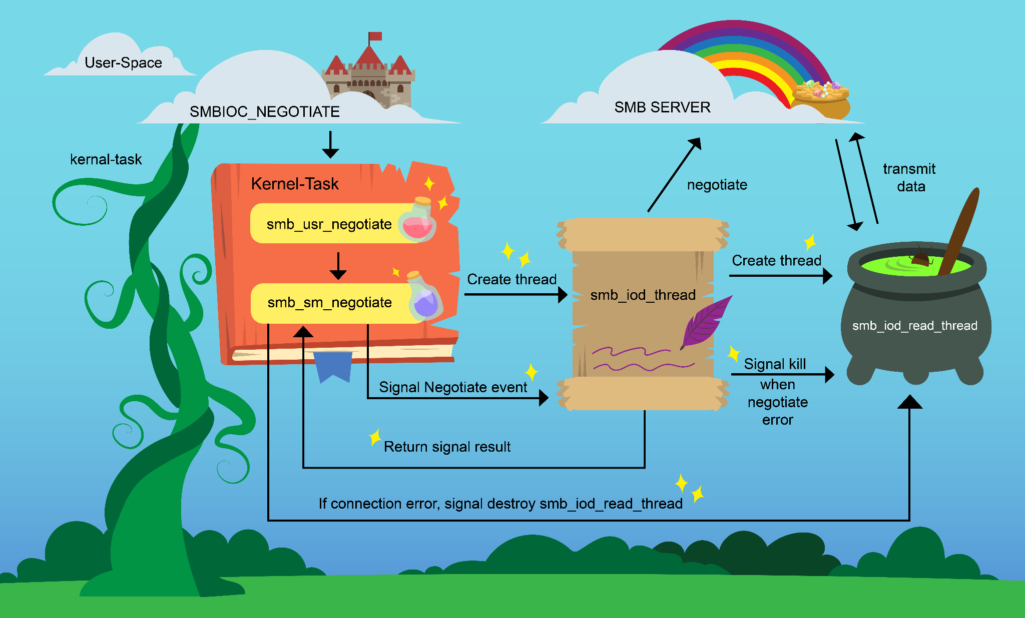
SMBIOC_NEGOTIATE OVERVIEW

Slide 16
2. Fuzzing Methodology

Slide 17
Three types of vulnerabilities that may exist in netsmb
Memory corruption during parsing and processing input from userland.
Race condition during processing multiple IOCTL commands in a shared smb_session.
Combination of (1) and (2).

Slide 18

Fun Fact

Slide 19

Why did I choose dumb Fuzzer?
Spending more time on auditing the target.
Focusing on mutation algorithms only.
Developing a dumb fuzzer is quick and easy.

Slide 20
Three parts of my fuzzer
Modeling IOCTL commands and structures.
The context of Fuzzer.
Mutation Strategies.

Slide 21
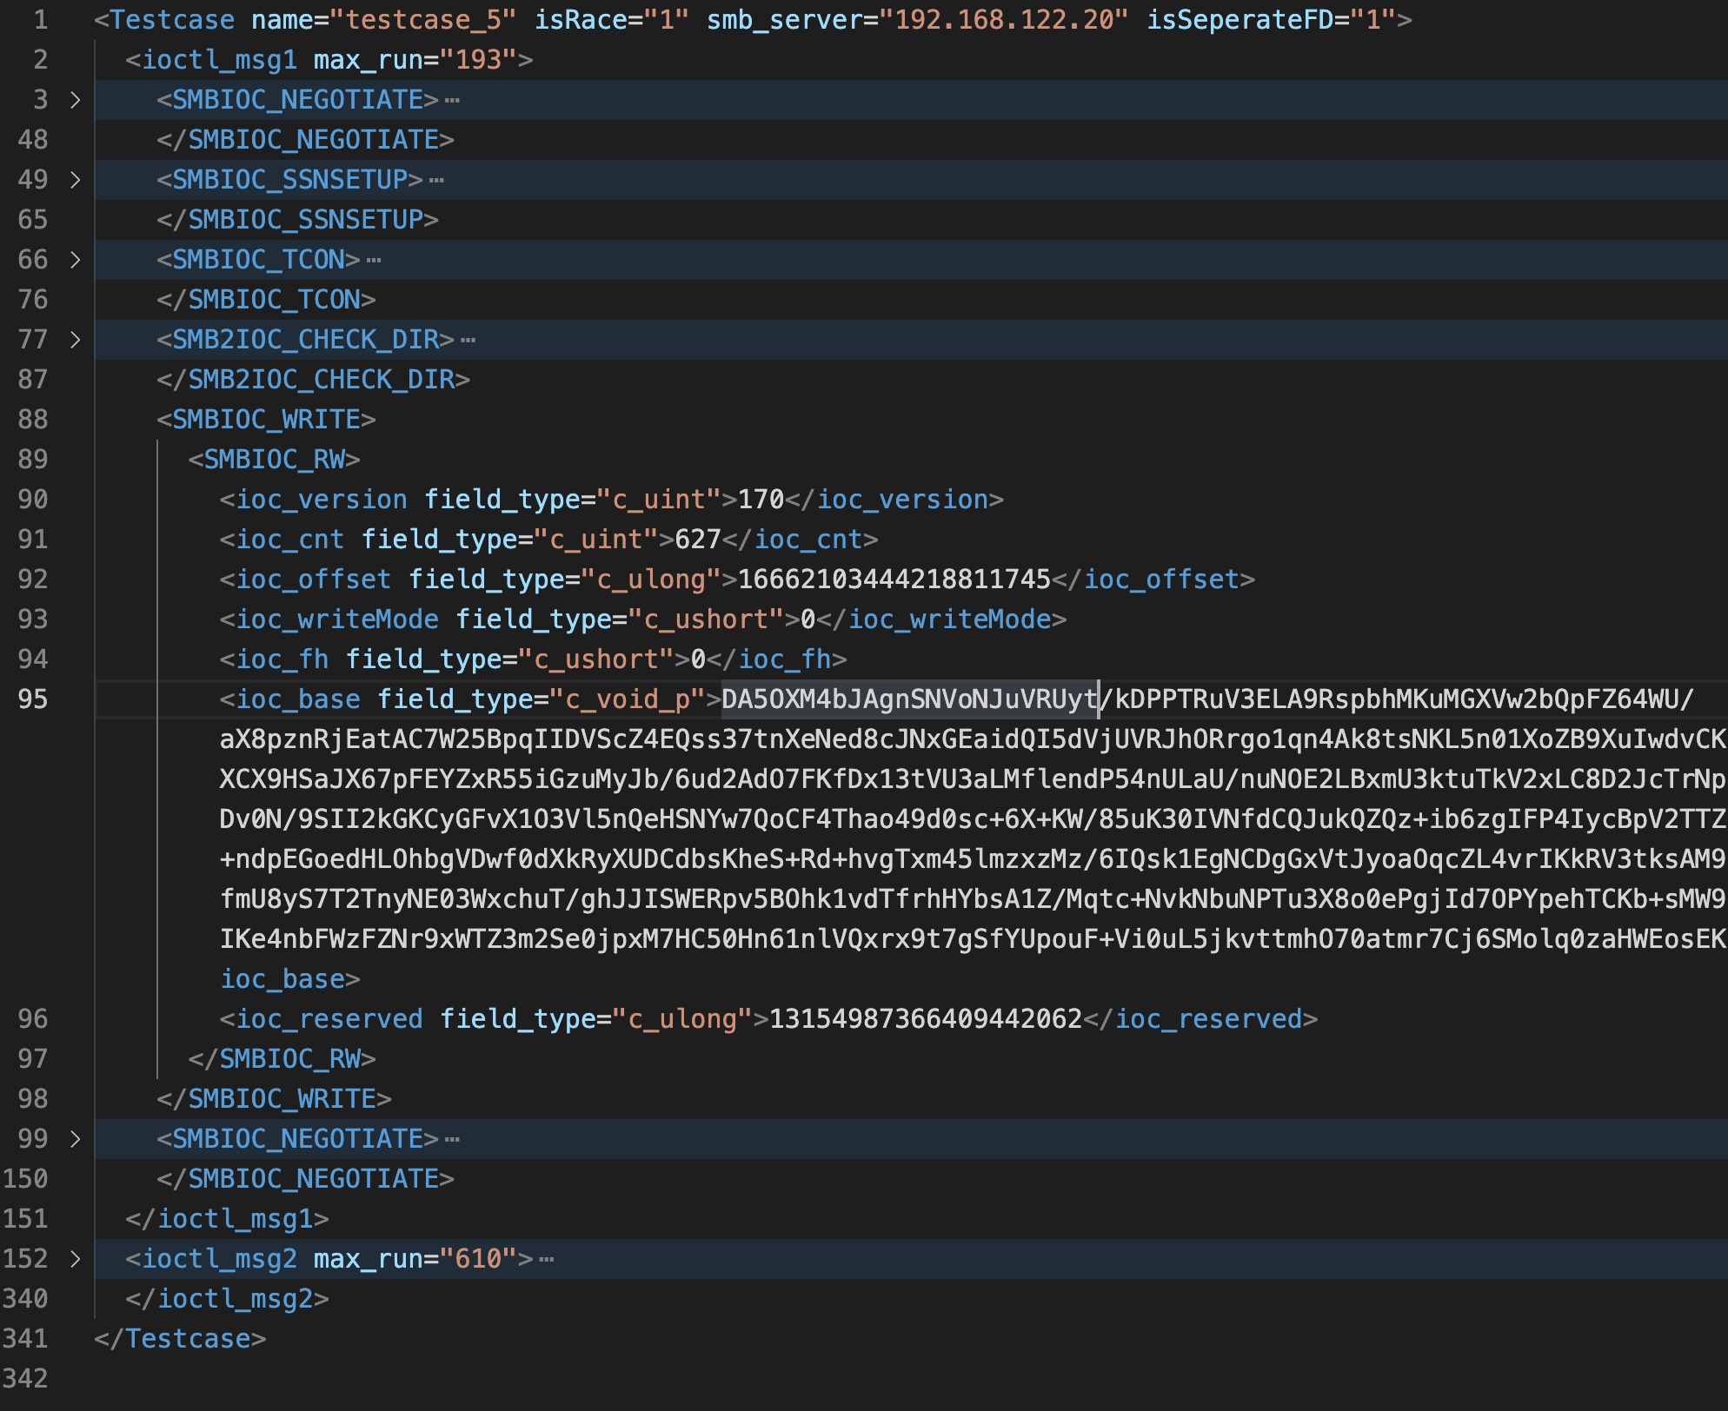
Part 1: Modeling IOCTL commands and structures
Build a generic XML structure to store information of a test case.
The XML structure must be serialized and deserialized in order to save and load the test case to the fuzzer.
This structure follows the below order:
The context of a test case: single thread or multiple thread.
The number of IOCTL commands in each thread.
The XML structure for each IOCTL command.

Slide 22
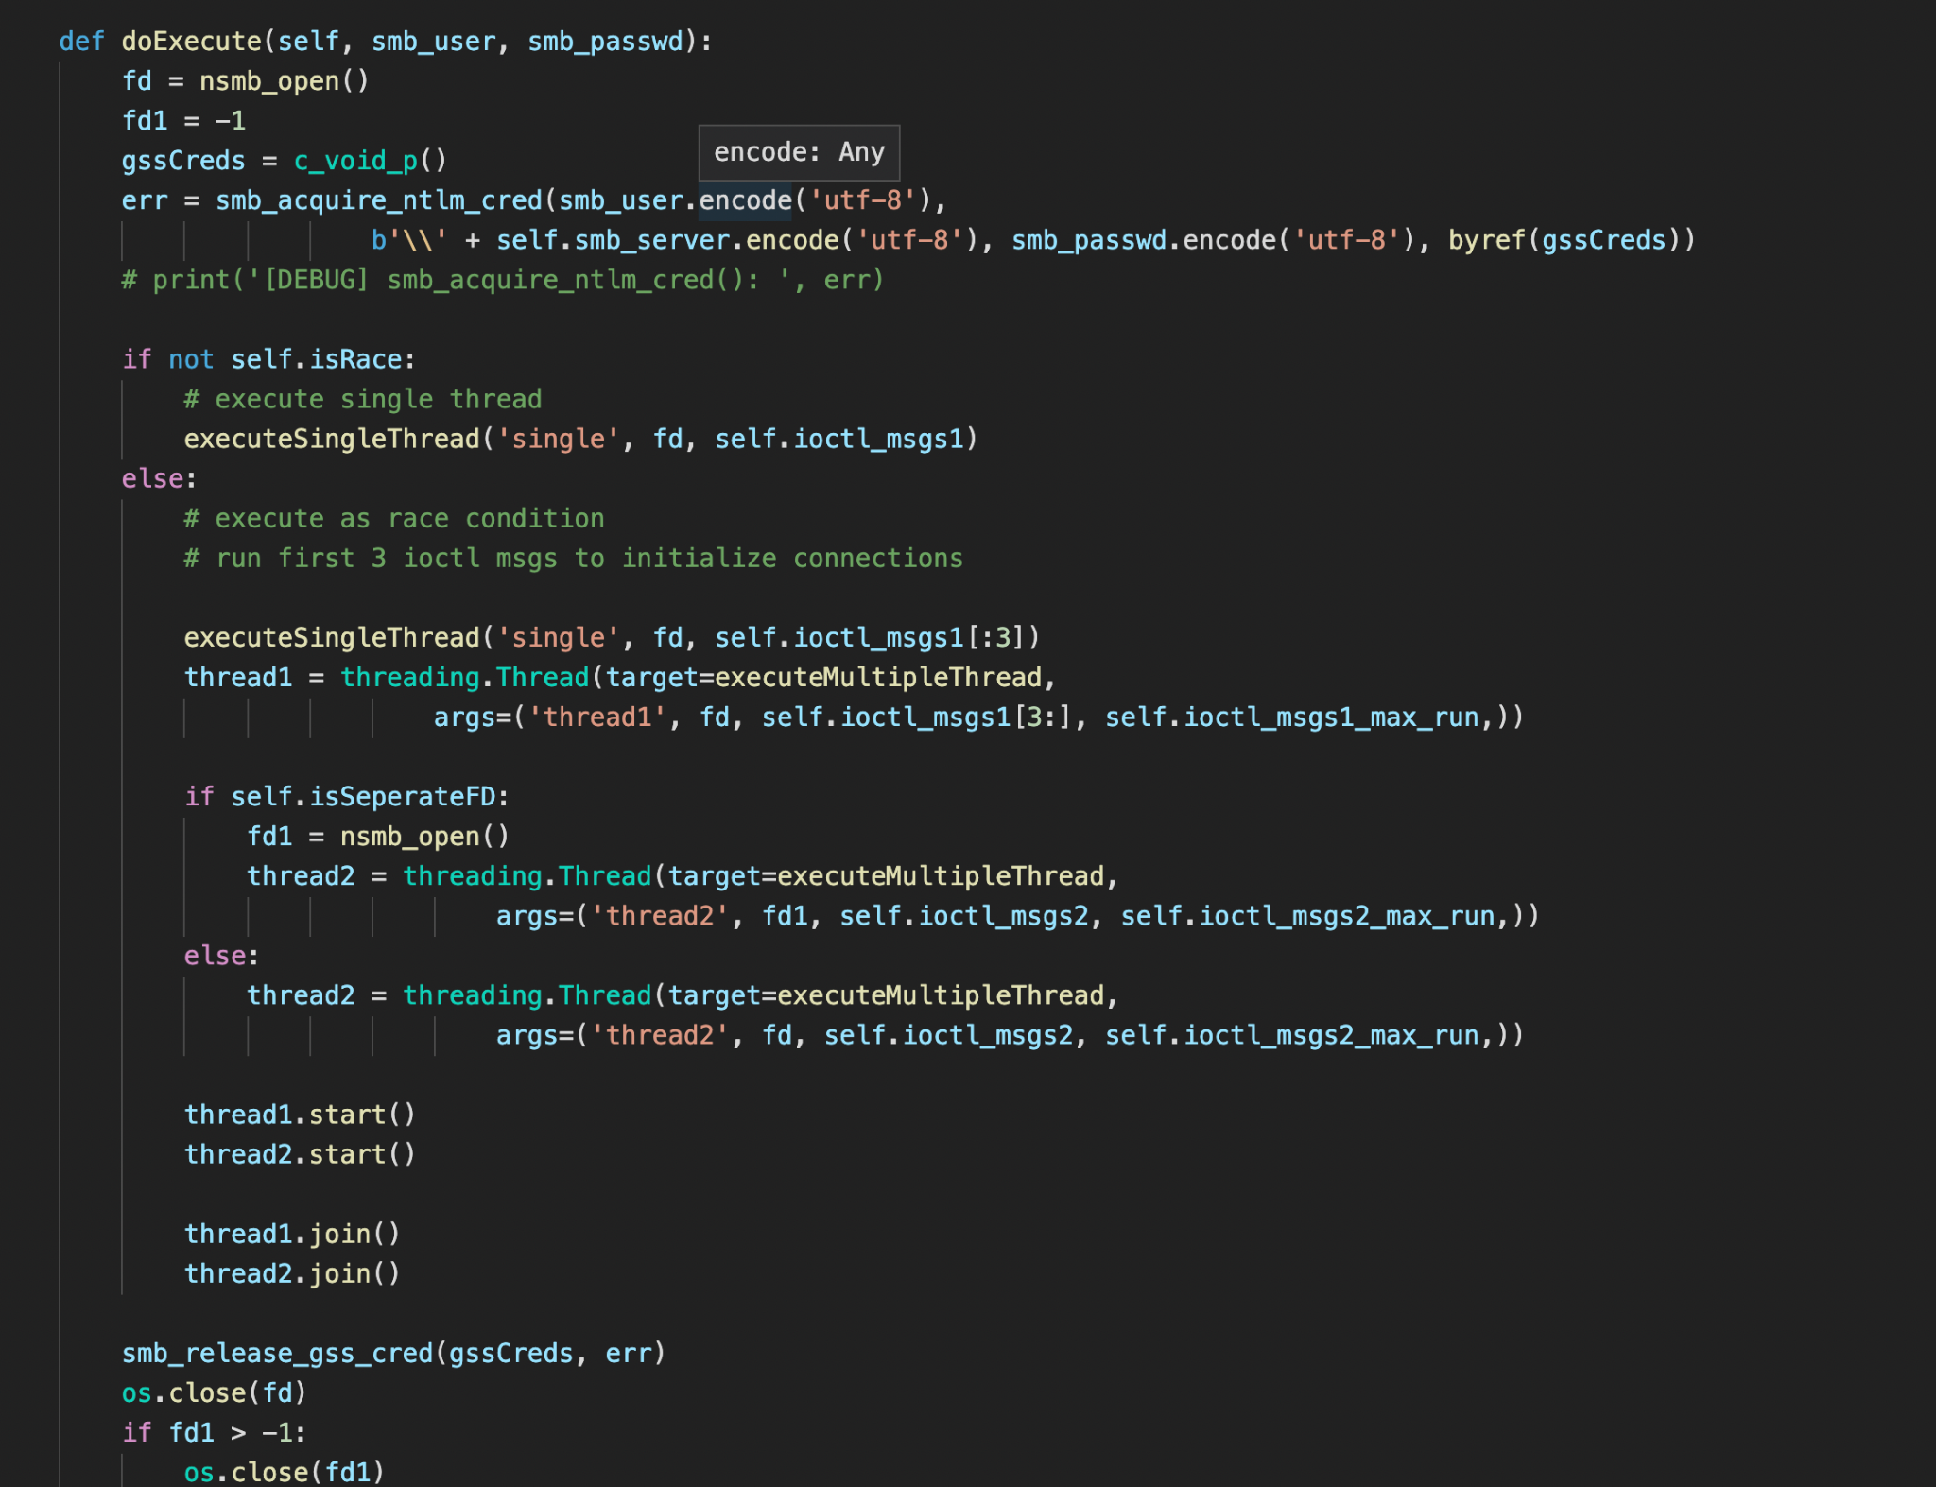
Part 2: The context of the fuzzer
What to focus?
The structure parsing in single thread context.
The multiple thread context on the same file descriptor between 2 threads.
The multiple thread context between 2 file descriptors sharing the same smb_session in 2 threads.

Slide 23
Part 3: Mutation Strategies
Mutating each attribute for each IOCTL structure.
Mutating the order of IOCTL commands for each thread.
Combination of (1) and (2)

Slide 24
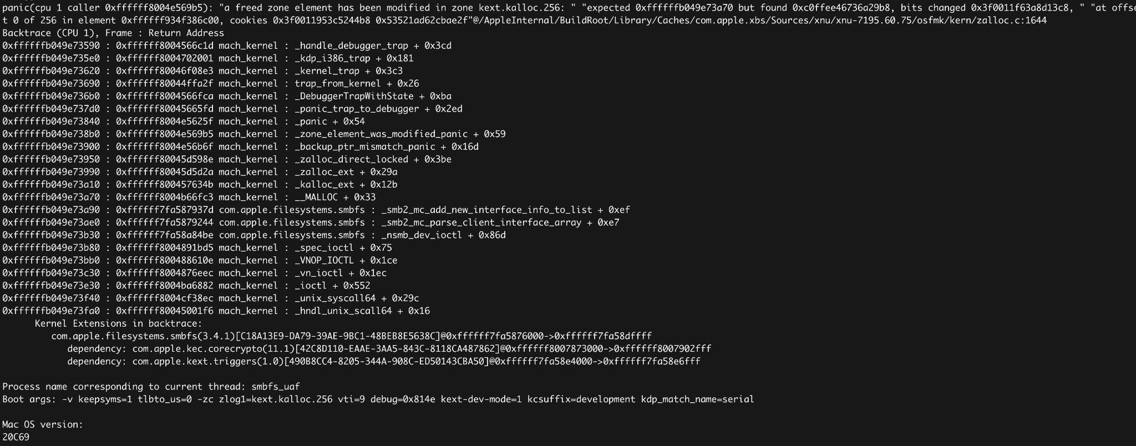
A day after…

Slide 25

Triaging the crash
XNU Zone Allocator has a btlog feature to trace the allocation and deallocation of a chunk in a zone.
Set boot-args: “-zc zlog=kext.kalloc.256”.
kernel.development has zonetriage command to read the btlog.
smbiod struct is the free object which is detected by Zone Allocator.

Slide 26
3. CVE-2021-30868
Root Cause Analysis

Slide 27
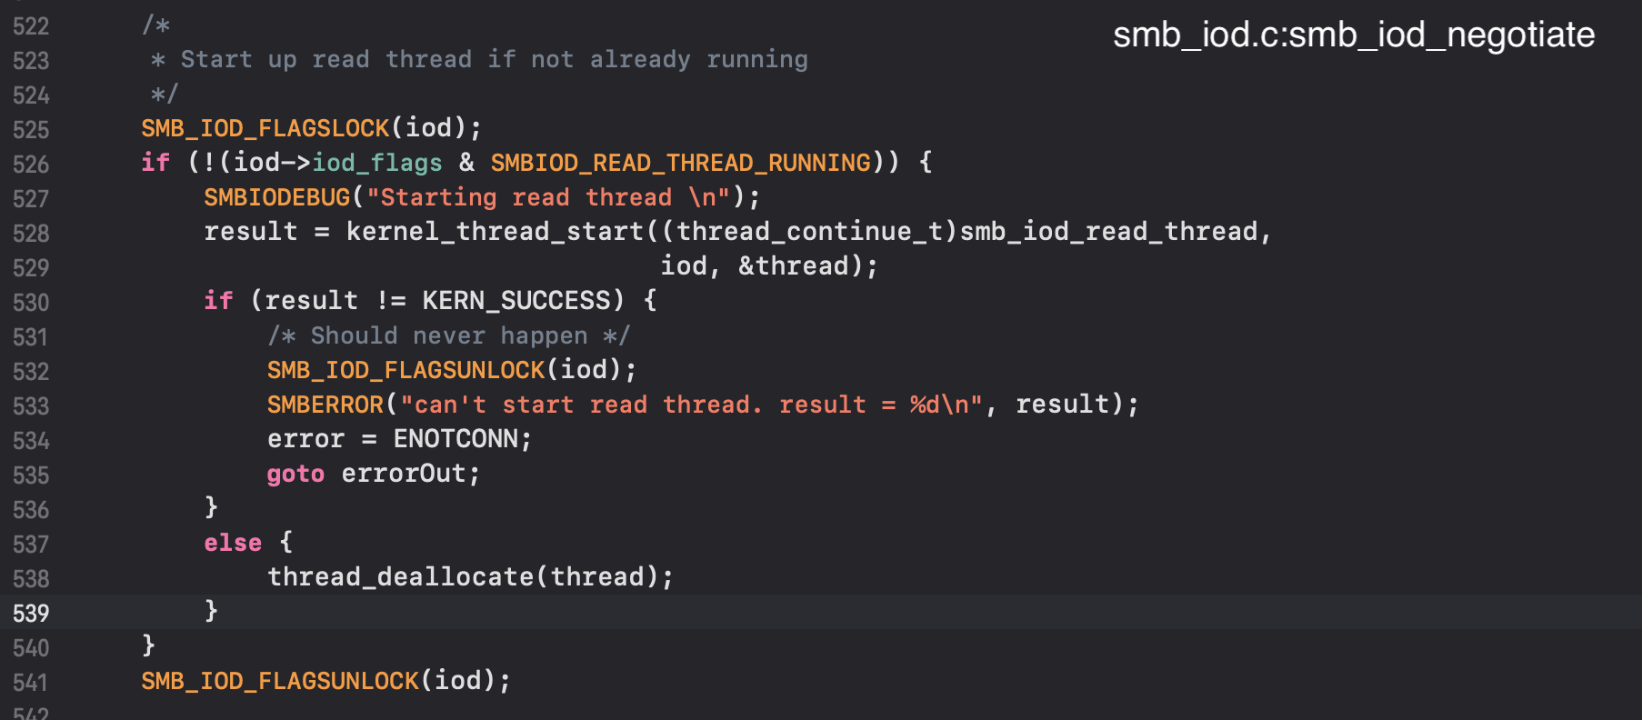
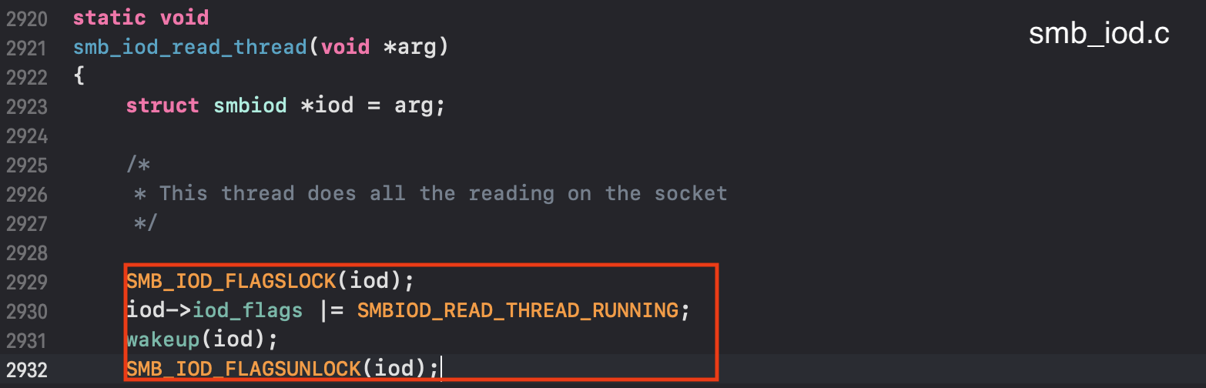
How was smb_iod_read_thread created?

Slide 28
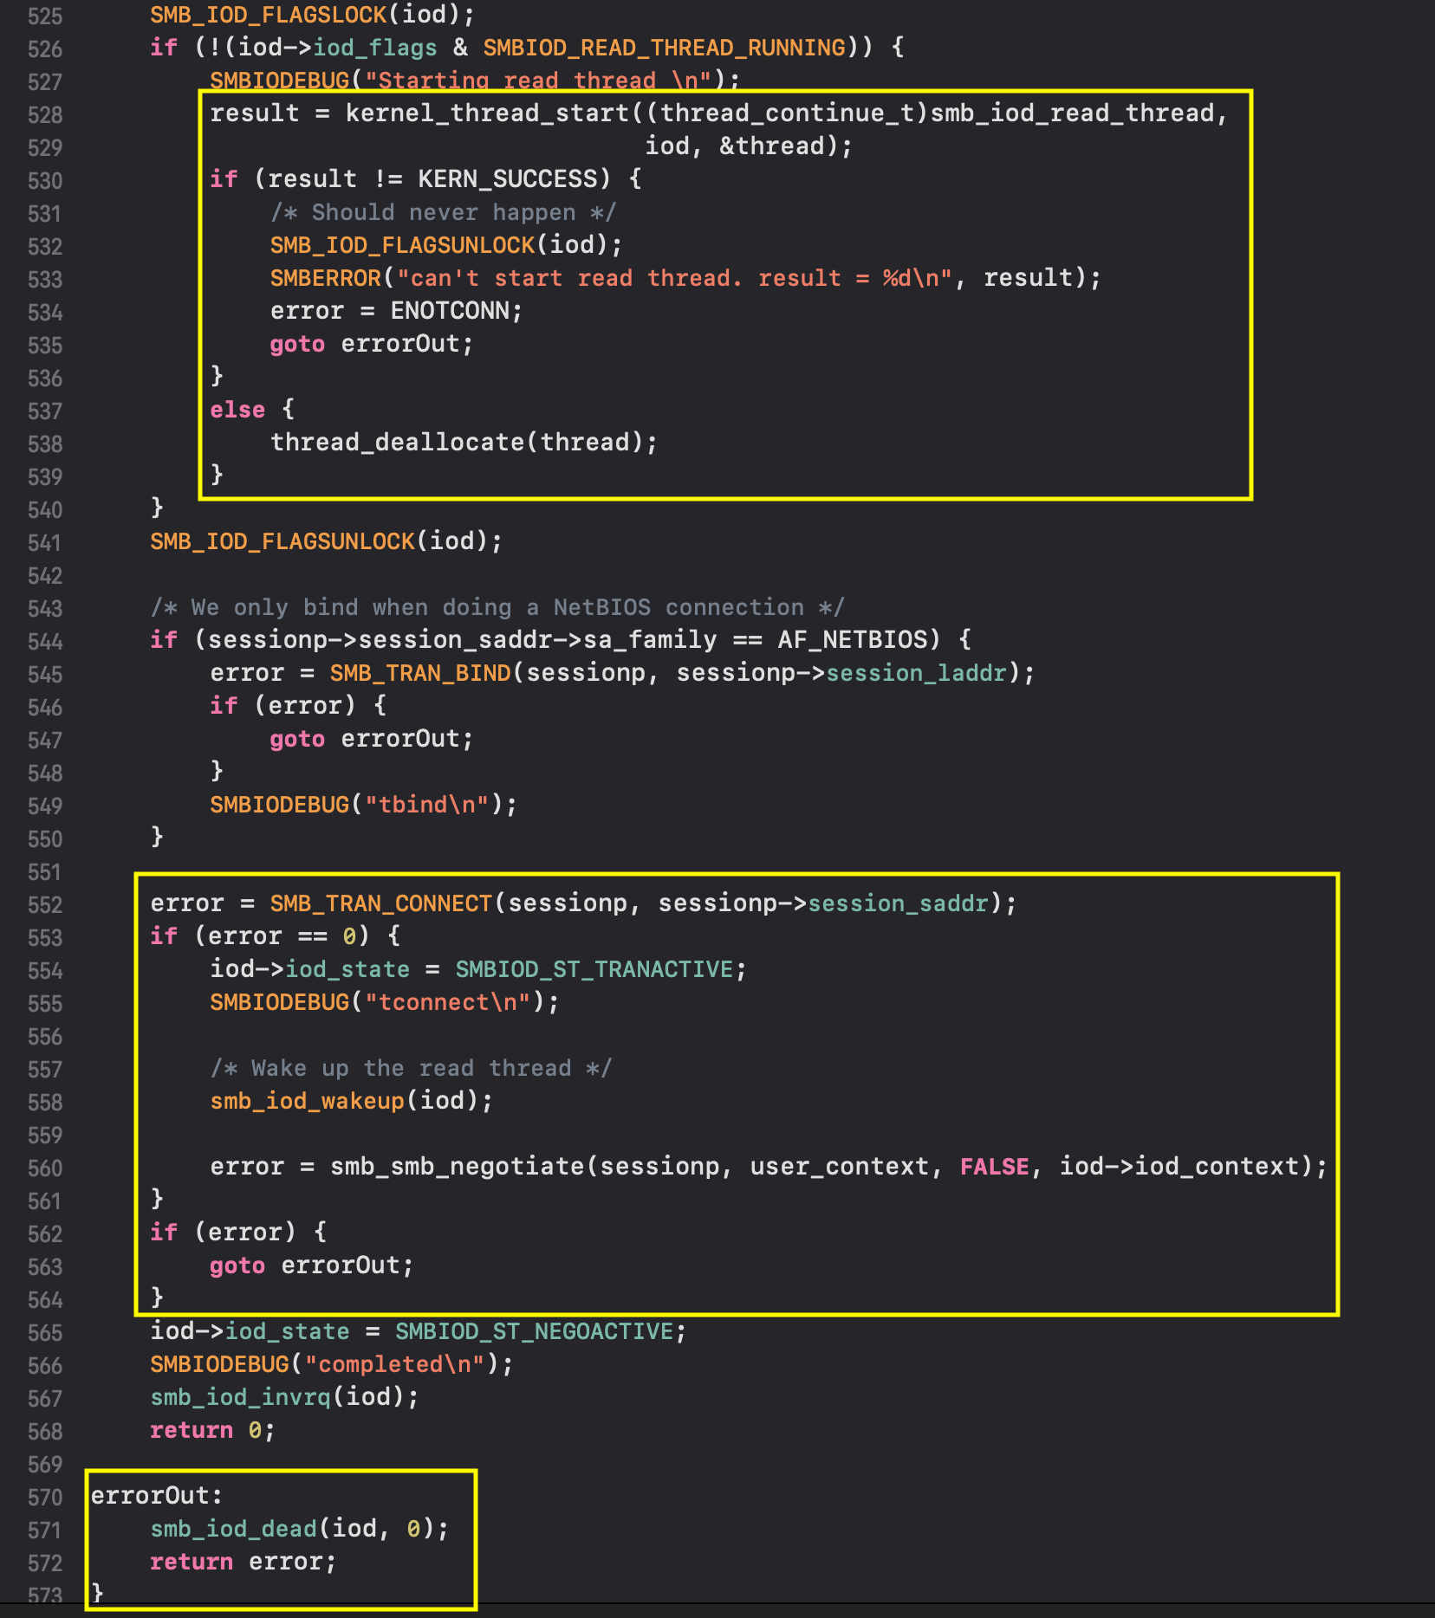
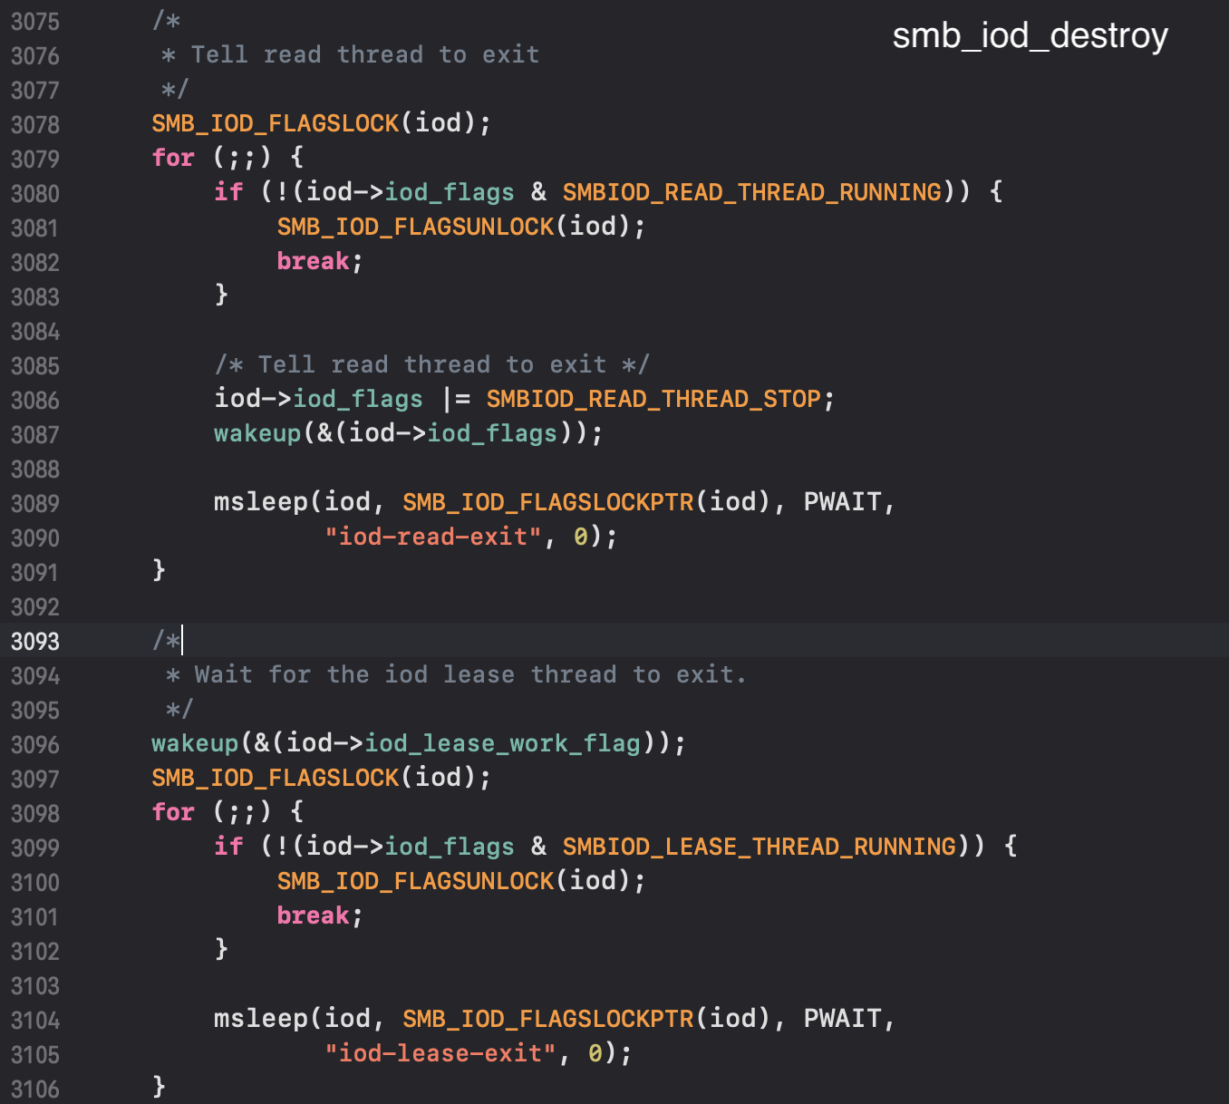
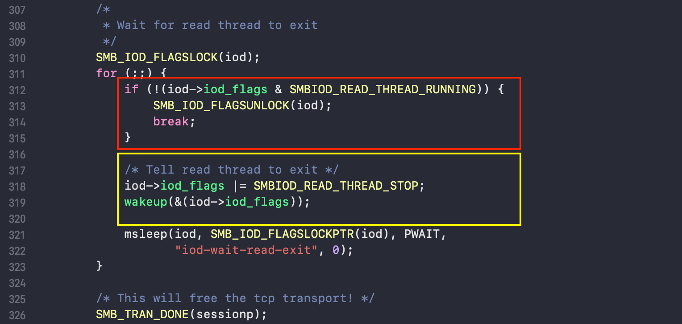
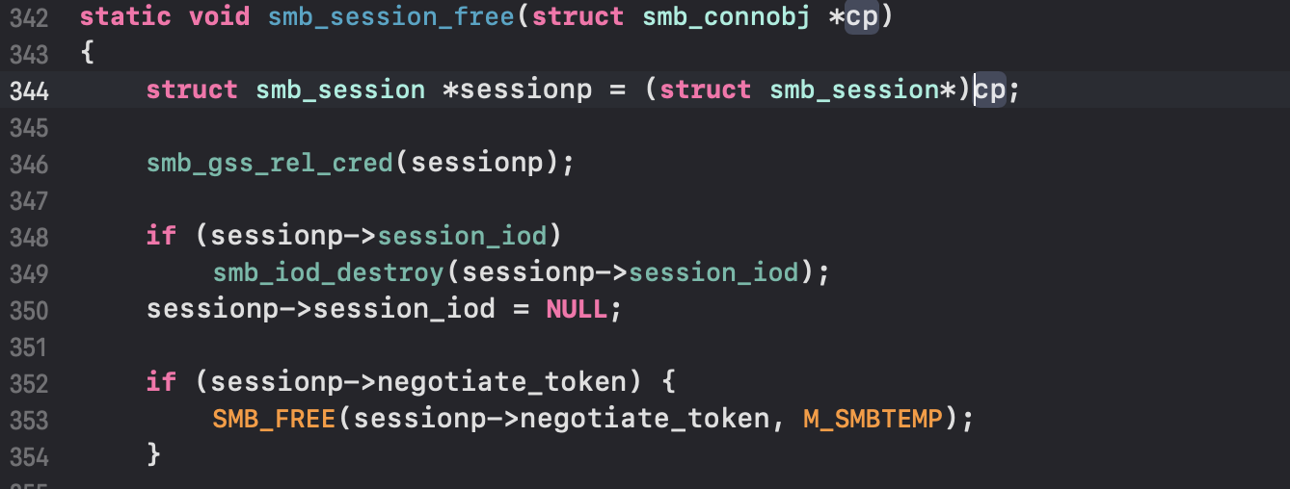
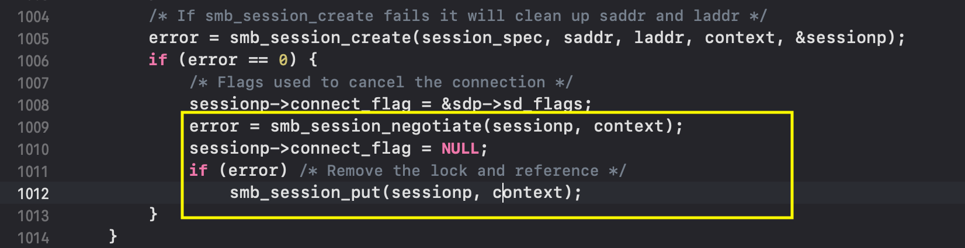
How did NEGOTIATE command handle an error of the connecting to samba server ?

Slide 29

What if smb_iod_read_thread does not actually start after kernel_thread_start is called ?

Slide 30
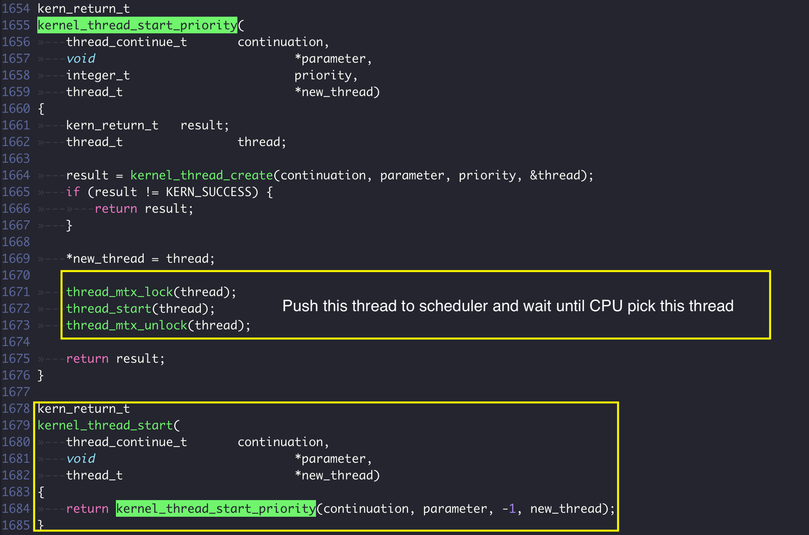
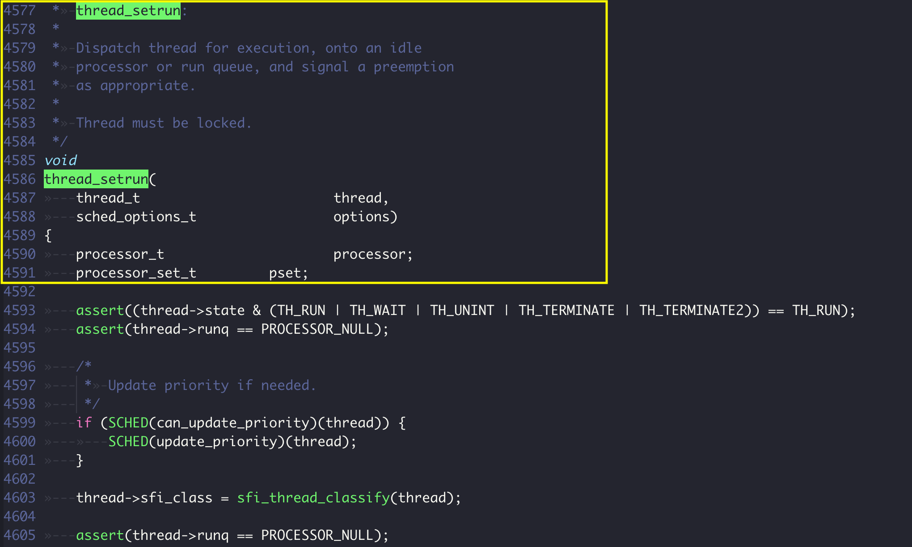
XNU kernel_thread_start

Slide 31
The root cause of the vulnerability

Slide 32

The limitation of this bug
The time frame between the free smbiod struct and the smb_iod_read_thread wake up is very short.
There are no other code path to make smb_iod_read_thread wait at SMB_IOD_LOCKS(iod).

Slide 33
4. CVE-2021-30868 Exploitation

Slide 34
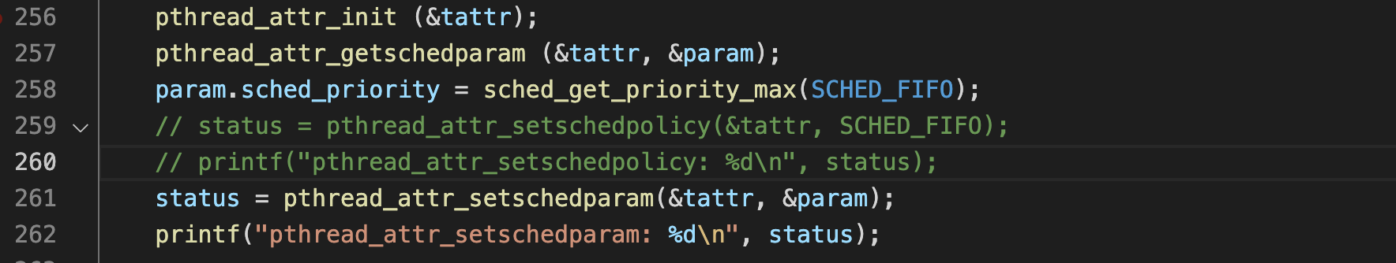
Operating System 101
Most modern OS support 3 common scheduler algorithms:
First-Come, First-Served (FCFS).
Priority Scheduling.
Round-Robin.
pthread is a library writing multi-thread program in C which helps to create a thread in FIFO queue or RR (Round-Robin) queue.

Slide 35

What if I create a lot of high priority threads/processes while running the PoC ?

Slide 36

OS Scheduler Abuse
Scheduler Queue

Slide 37
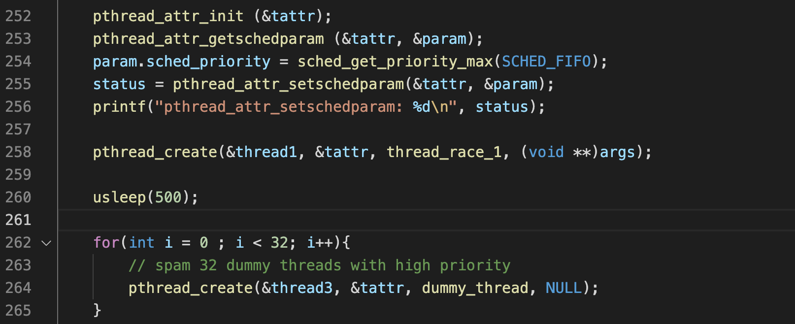
OS Scheduler Abuse

Slide 38
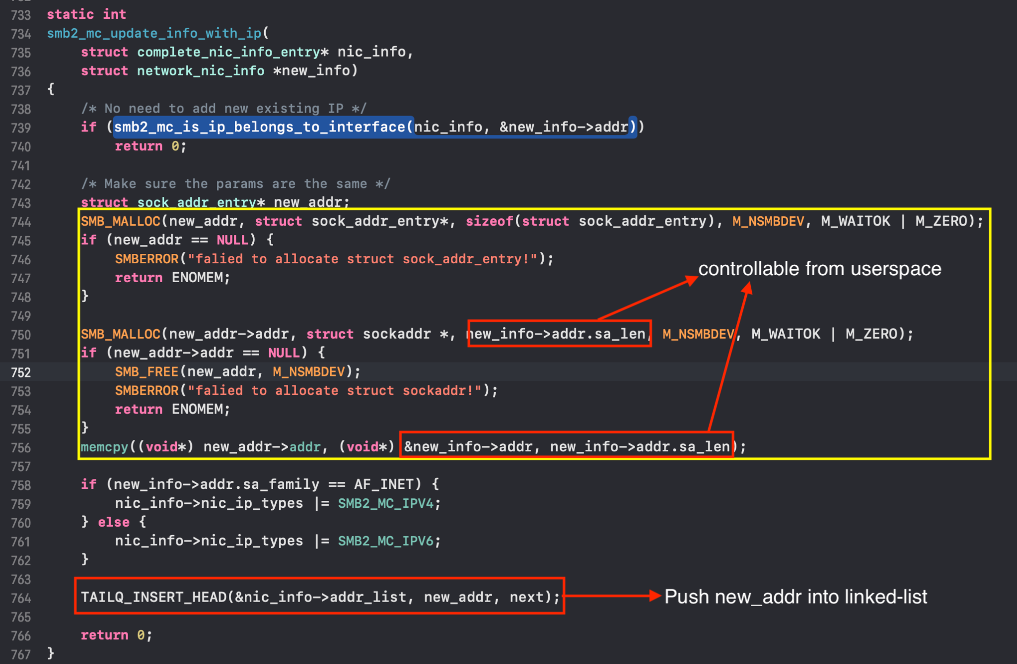
Reclaiming freed smbiod struct
smbiod is allocated in kext.kalloc.256.
SMBIOC_UPDATE_CLIENT_INTERFACES command allocates many chunks in kext.kalloc.256 and saves them into a linked-list.

Slide 39
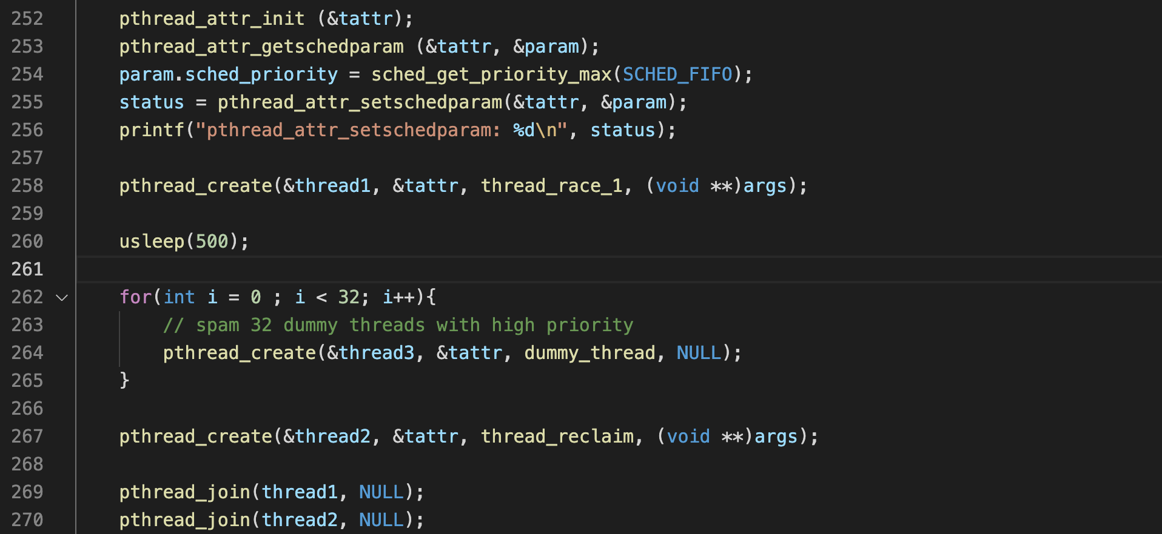
Putting those ideas together…

Slide 40
5. Demo

Slide 41
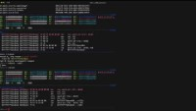
Demo

Slide 42
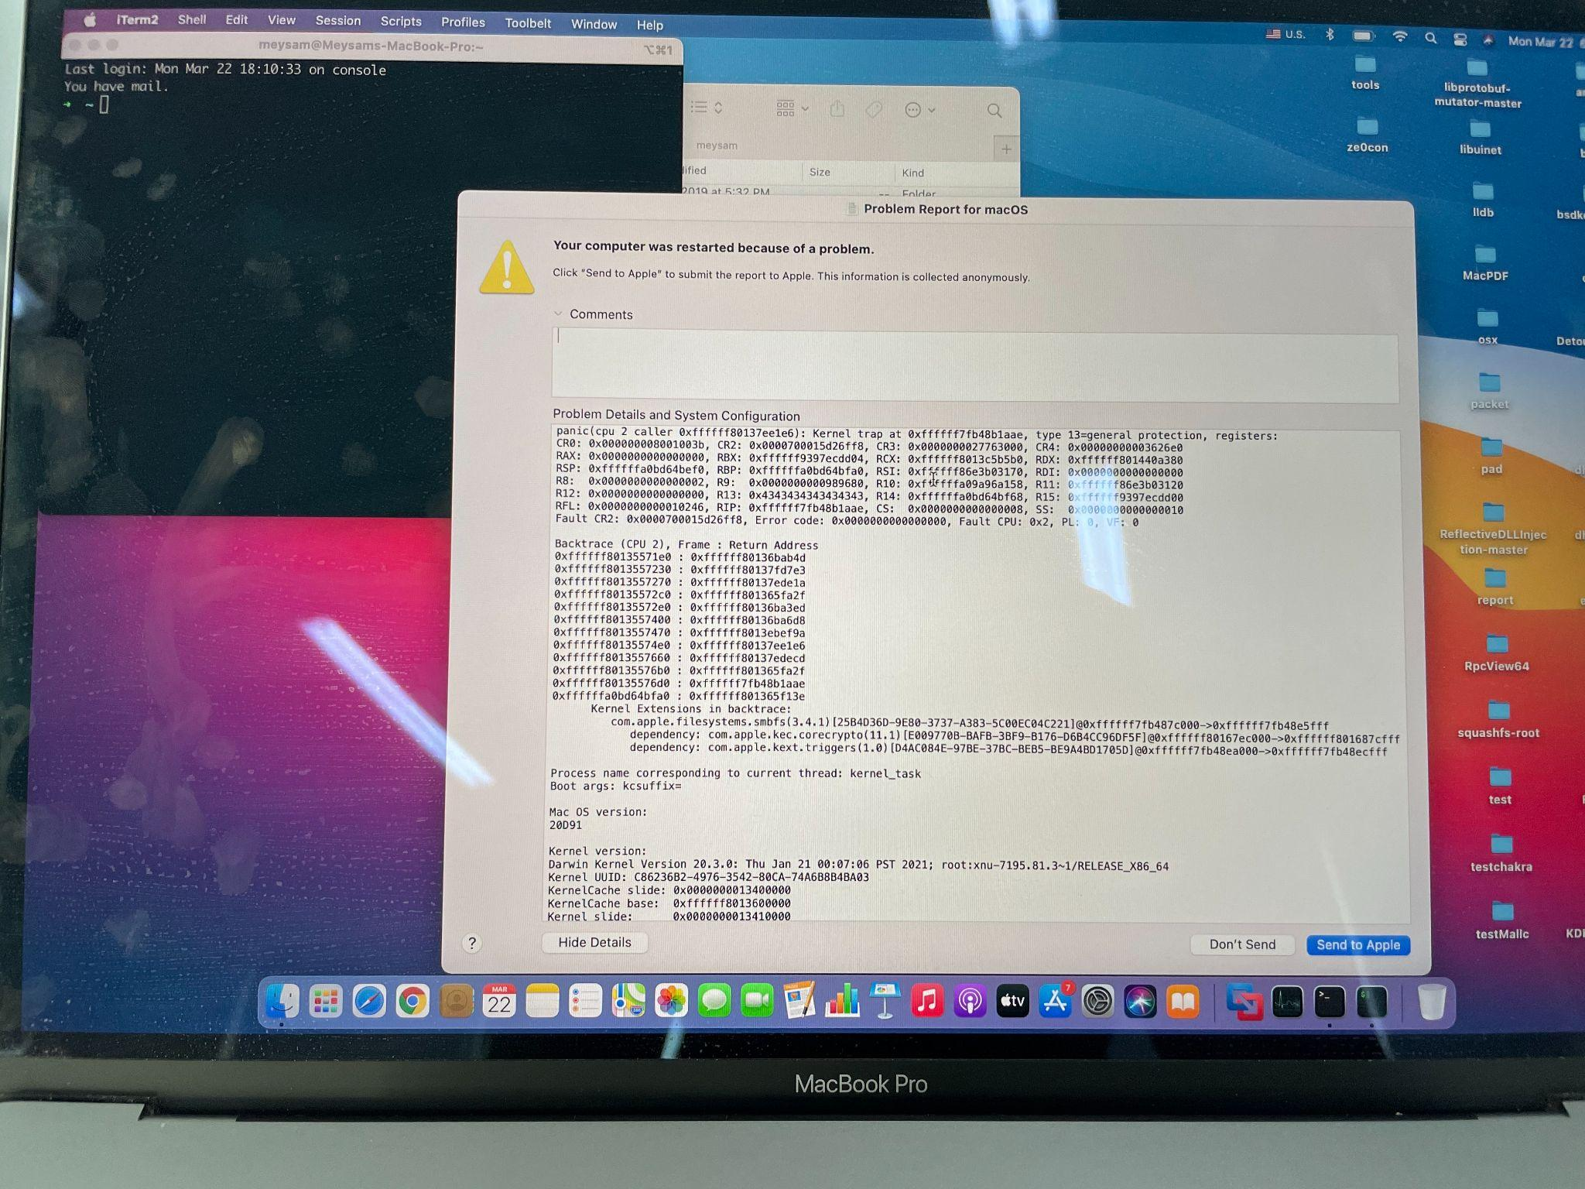
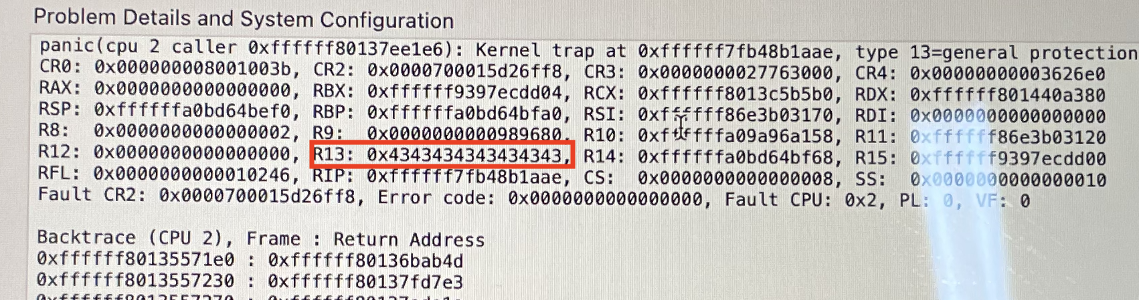
Macbook pro 2018 15inch screenshot

Slide 43
6. Q&A

Slide 44
Thank you!

